Slide 1

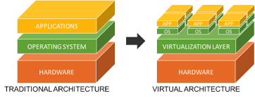


Module 2: Virtualization

Slide 2
Outline
2.1 Introduction, Characteristics of Virtualized Environments, Taxonomy of Virtualization Techniques, Virtualization and Cloud Computing, Pros and Cons of Virtualization
2.2 Technology Examples: Xen: Para virtualization, VMware: Full Virtualization, Microsoft Hyper-V
2.3 Cloud Computing Architecture : Cloud Reference Model, Types of Clouds, Economics of the Cloud, Open Challenges

Slide 3
What is Virtualization?
The Software methods (including hypervisors) used to allow multiple virtual computing resources to run on a single hardware platform.
What is a VM?
A Software Virtualization of a Computer Hardware that executes program like a physical computer and can be interacted with like a physical computer.

Slide 4
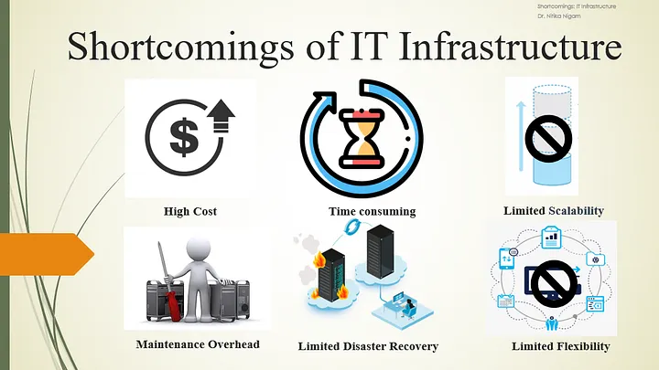
Traditional IT Infrastructure

Slide 5
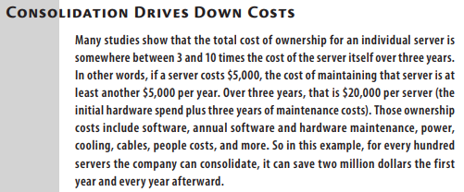
Notes:
Result:
100 physical servers → maybe 10–15 powerful servers
Without virtualization:
CPU usage ≈ 5–15%
Memory underutilized
With virtualization:
CPU usage ≈ 60–80%
Memory shared efficiently
👉 Result:
Fewer machines do more work
3️⃣ Huge
Huge cost savings (this answers your previous question)
Because:
Fewer servers to buy
Less electricity
Less cooling
Less maintenance
Fewer admins needed
👉 Result:
Millions of dollarsBetter isolation and reliability
Each VM is isolated
One VM crash ≠ entire server crash
👉 Result:
Higher reliability
Better fault isolation
saved every year

Slide 6
Earlier, whenever a company needed a new server, it bought new hardware. After virtualization became popular, companies started creating virtual servers instead. By 2009, the number of virtual servers exceeded physical servers, and this gap kept increasing

Slide 7
2. Virtualization defined again
Virtualization is a technology or methodology that enables the generation of a virtual representation, as opposed to a tangible one, of entities like hardware, storage devices, or network resources.
It abstracts the foundational physical elements, permitting the operation of multiple virtual instances or environments on a solitary physical system.
Notes:
Result:
100 physical servers → maybe 10–15 powerful servers
Without virtualization:
CPU usage ≈ 5–15%
Memory underutilized
With virtualization:
CPU usage ≈ 60–80%
Memory shared efficiently
👉 Result:
Fewer machines do more work
3️⃣ Huge
Huge cost savings (this answers your previous question)
Because:
Fewer servers to buy
Less electricity
Less cooling
Less maintenance
Fewer admins needed
👉 Result:
Millions of dollarsBetter isolation and reliability
Each VM is isolated
One VM crash ≠ entire server crash
👉 Result:
Higher reliability
Better fault isolation
saved every year

Slide 8
3. Virtualization Benefits
Resource Efficiency
Cost Savings
Flexibility and Scalability
Improved Disaster Recovery
Isolation and Security
High Availability (movement of VMs between physical servers with minimal downtime)
Energy Efficiency
Centralized Management
Notes:
https://medium.com/@a2zlearningzone/delving-into-bell-and-whistle-of-virtualization-part-1-5e12ce91fb68

Slide 9
Companies usually adopt virtualization-first policies, which state that as new projects come in house, any server requirements will be satisfied by the virtual resources, rather than by paying for new physical resources. Actual hardware will be purchased only if it it can be proven that the need cannot be satisfied with the virtual environment
Notes:
Result:
100 physical servers → maybe 10–15 powerful servers
Without virtualization:
CPU usage ≈ 5–15%
Memory underutilized
With virtualization:
CPU usage ≈ 60–80%
Memory shared efficiently
👉 Result:
Fewer machines do more work
3️⃣ Huge
Huge cost savings (this answers your previous question)
Because:
Fewer servers to buy
Less electricity
Less cooling
Less maintenance
Fewer admins needed
👉 Result:
Millions of dollarsBetter isolation and reliability
Each VM is isolated
One VM crash ≠ entire server crash
👉 Result:
Higher reliability
Better fault isolation
saved every year

Slide 10
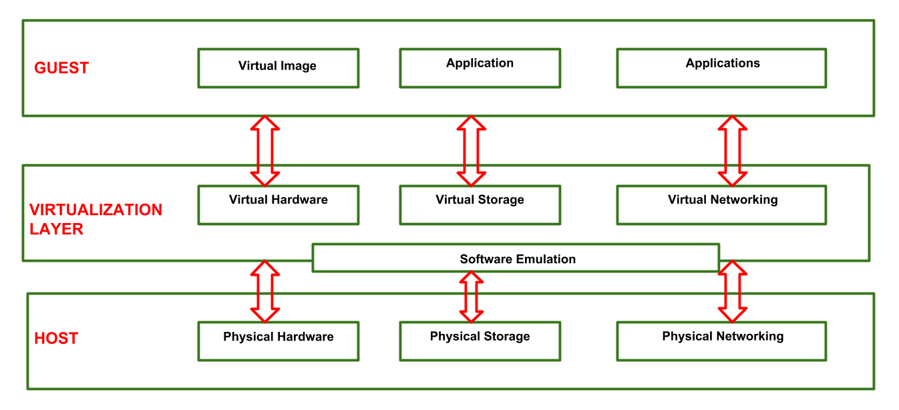
4. Virtualization Reference Model

Slide 11
Virtualization Reference Model
Guest (Virtual Machine): acts as the element that interacts with the virtualization layer instead of the typical host.
Host (Physical Hardware): represents the initial environment where the guest is intended to operate.
Virtualization layer (Hypervisor): takes on the role of replicating either an identical or an alternative environment in which the guest operates

Slide 12
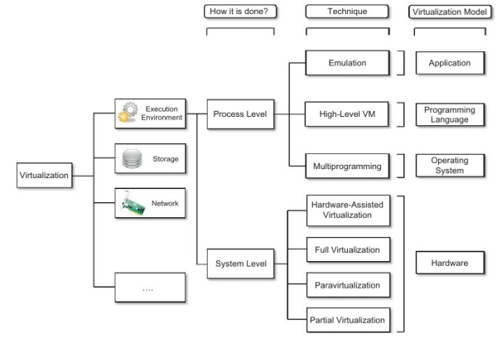
5. Virtualization Techniques Taxonomy
Notes:
Android Emulator on laptop
Emulation is a software-based technique that reproduces the behavior of another system’s hardware or software, enabling programs designed for one platform to run on a different platform at the cost of performance.

Slide 13
5. Virtualization Techniques Taxonomy
What is virtualized?
Execution environment
Storage
Network
Memory, I/O
➡ Leads to:
Server virtualization
Storage virtualization
Network virtualization
At what level is virtualization done?
Process-level
System-level
➡ Leads to:
JVM, containers
Full OS virtual machines
How is virtualization implemented?
Emulation
Full virtualization
Paravirtualization
Hardware-assisted virtualization
➡ Leads to:
Hypervisors
CPU support (Intel VT-x)

Slide 14
5. Virtualization Techniques Taxonomy
Process-level virtualization means:
A single program (process) is given a virtual execution environment that is independent of the underlying OS and hardware.
Virtualization applies to one process, not the whole OS
Program sees a virtual machine / abstract machine
The JVM is a software-defined virtual machine created for one process.
Same .class file runs on: Windows JVM, Linux JVM, macOS JVM. No recompilation needed (platform independence)

Slide 15
5. Virtualization Techniques Taxonomy
The JVM is an example of process-level virtualization because it provides a complete virtual execution environment with its own instruction set (Bytecode), memory model (Stack and Heap), and runtime services for a single process, whereas the Python interpreter directly executes code using host OS resources without creating a virtual machine abstraction.

Slide 16
5. Virtualization Techniques Taxonomy
Multiprogramming is a type of process virtualization: Multiple processes are kept in memory and CPU switches rapidly between them. Only one process executes at a time. But all processes appear to run simultaneously. This is done using: Context switching, Scheduling, and Memory protection.
Notes:
Each process is:
Isolated
Protected
Abstracted from others

Slide 17
5. Virtualization Techniques Taxonomy
An emulator is a software system that imitates the hardware and instruction set of another machine, allowing programs compiled for one architecture to run on a different architecture.
Example- Android Emulator
An emulator is classified as process-level virtualization because-
It runs as a single process on the host OS
It virtualizes the execution environment of a program
It does not virtualize the entire physical machine directly
It does not require the host and guest to have the same CPU architecture.
Notes:
An 8086 emulator (like the ones used to run old DOS/assembly programs) runs as a normal application (process) on a host OS and creates a virtual CPU environment for the 8086 instruction set.

Slide 18
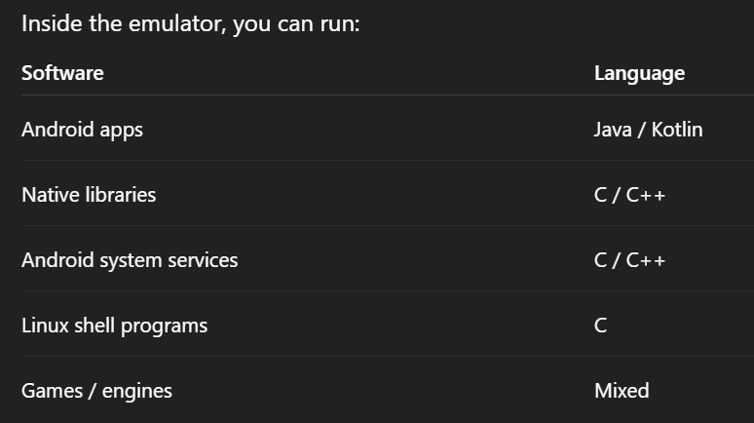
The emulator does not change for any of these.
➡️ Therefore, the emulator does not depend on the programming language.

Slide 19
6. Machine Reference Model

Slide 20
6. Machine Reference Model
When an execution environment is virtualized then it requires a reference model which defines the interfaces within the level of abstractions
It describes the interfaces between applications, operating systems, and hardware, showing how instructions and calls flow through a computing system.
This level of abstraction hides the details of implementations. Virtualization techniques can substitute any one layer and can intercept the calls which are directed to it.

Slide 21
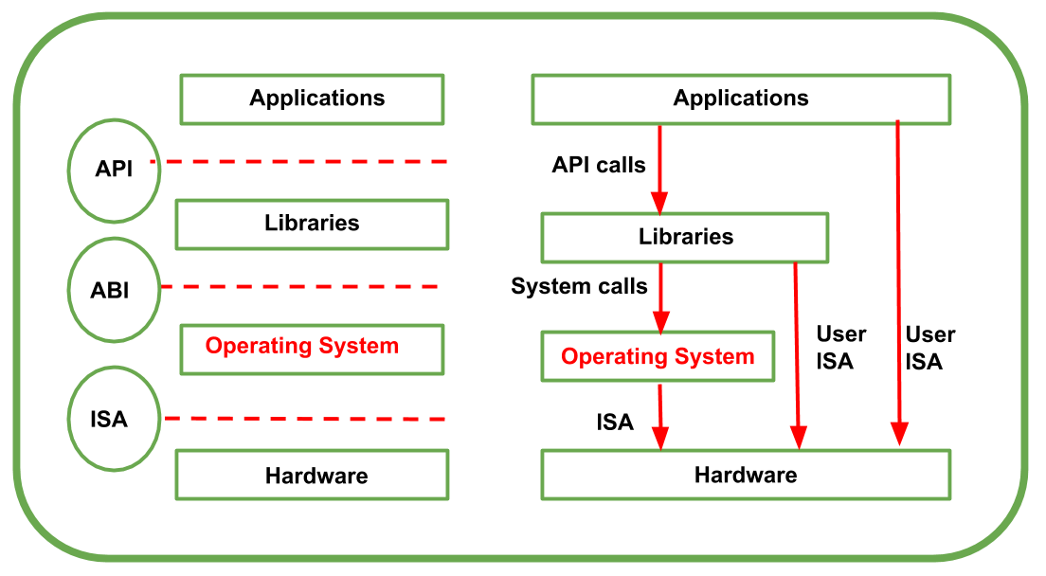
API –Application Programming Interface
ABI – Application Binary Instructions
ISA – Instruction Set Architecture
Machine Reference Model
Notes:
API –Application Programming Interface
ABI – Application Binary Instructions
ISA – Instruction Set Architecture

Slide 22
Machine Reference Model
Applications
User programs (browser, editor, database, etc.)
Written by developers
Libraries
Provide reusable functions
Examples: C standard library (glibc), Java libraries
Hide OS complexity from applications
Operating System
Kernel + system services
Manages:
CPU scheduling
Memory
I/O devices
Acts as a control layer between software and hardware
Hardware
CPU, RAM, disk, network card
Executes machine instructions

Slide 23
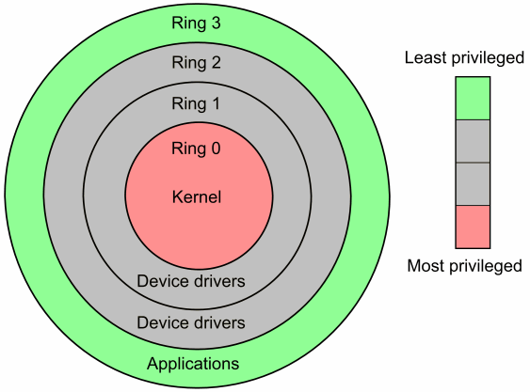
CPU instructions, Memory, Hardware devices, Process scheduling,Interrupt Handling
Machine Reference Model
The privilege ring model divides CPU execution into levels (rings) so that the most critical code runs with the highest privilege and user programs run with the least privilege.
Browser, Editor, Java program, Python script
Security Rings

Slide 24
Machine Reference Model
CPU runs on two privilege levels:
1. User Mode: In this mode, memory access is restricted up to some limit whereas access to peripherals is denied.
2. Kernel Mode:
CPU has instructions which manage memory and how to be accessed and it also has instructions which enable access of the peripherals like disks and network cards.
From one running program to another running program, CPU switches automatically.

Slide 25
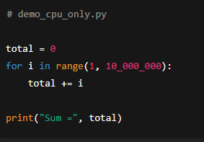
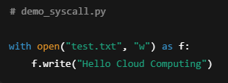

Slide 26
5. Virtualization Techniques Taxonomy
Notes:
Result:
100 physical servers → maybe 10–15 powerful servers
Without virtualization:
CPU usage ≈ 5–15%
Memory underutilized
With virtualization:
CPU usage ≈ 60–80%
Memory shared efficiently
👉 Result:
Fewer machines do more work
3️⃣ Huge
Huge cost savings (this answers your previous question)
Because:
Fewer servers to buy
Less electricity
Less cooling
Less maintenance
Fewer admins needed
👉 Result:
Millions of dollarsBetter isolation and reliability
Each VM is isolated
One VM crash ≠ entire server crash
👉 Result:
Higher reliability
Better fault isolation
saved every year

Slide 28
Knowledge Check
Q1. Which dimension of taxonomy answers the question: “At what level is virtualization applied?”
Q2. Is JVM an example of process-level or system-level virtualization? Why?
Q3. Which interface binds an operating system to a specific processor architecture?
Q4. Which interface separates applications from libraries in the machine reference model?
Q5. What happens first: API call or system call?
Notes:
Installing a programming language does not imply virtualization. Only languages that execute on a defined virtual machine (like JVM or CLR) are considered process-level virtualization.

Slide 29
System Level based/ Hardware Virtualization Types

Slide 30
System Level based/ Hardware Virtualization
methods and technologies that enable multiple virtual machines (VMs) to run on a single physical computer or server.
isolate and run multiple operating systems and applications on the same hardware simultaneously.
benefits such as resource isolation, improved utilization of hardware resources, and increased flexibility in managing and deploying software workloads.

Slide 31
6. Types of Virtualization (How)
Full Virtualization
Hardware assisted Virtualization
Para Virtualization
Partial Virtualization

Slide 32
Types of Virtualization- Full Virtualization

Slide 33
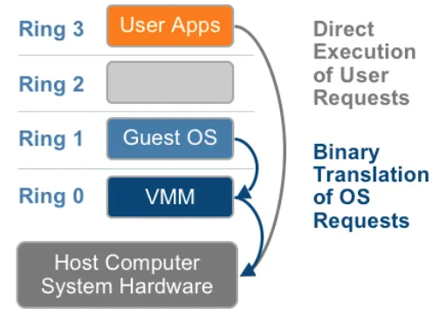

Slide 34
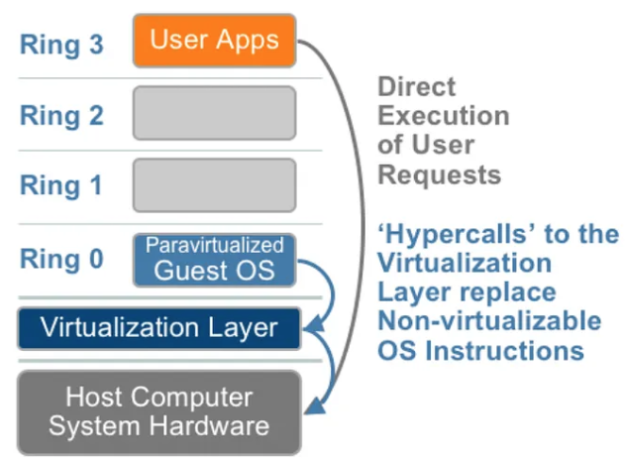

Slide 35
FULL
PARA

Slide 36
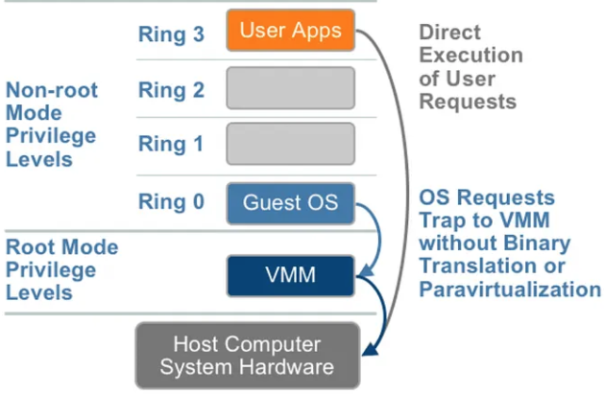
FULL
PARA
OS requests cause VM-exit to VMM (CPU-assisted)
HARDWARE ASSISTED

Slide 37
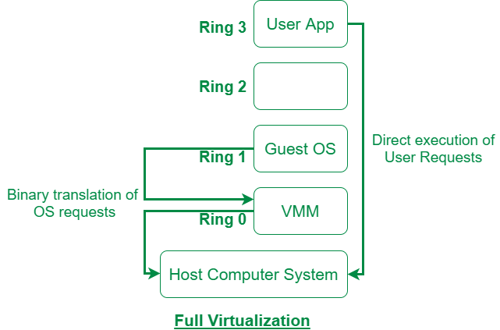
Types of Virtualization- 1. Full Virtualization
Full Virtualization completely virtualizes the underlying hardware.
The guest OS is unaware that it is running inside a virtual machine.
Hypervisor/VMM emulates the entire hardware
Privileged instructions are handled by the hypervisor (binary translation / trap-and-emulate)
In full virtualization, the guest operating system runs in Ring 1 while the hypervisor occupies Ring 0, ensuring complete control over hardware resources.

Slide 38
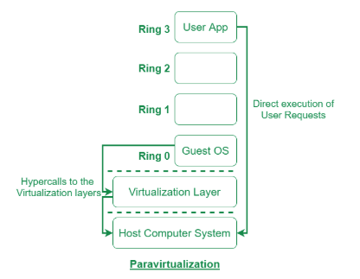
Types of Virtualization- 2. Para Virtualization
Guest operating system is modified to be aware of the hypervisor and explicitly cooperates with it.
For privileged instructions, the guest OS makes hypercalls to the hypervisor. (no trap happens)

Slide 39
Difference between Full and Para Virtualization
Aspect | Full Virtualization | Para Virtualization
Guest OS awareness | Unaware | Aware
Guest OS placement | Ring 1 | Ring 0
How hypervisor is invoked | Trap / binary translation | Hypercall
Hypervisor involvement | Reactive | Proactive
Performance | Lower | Higher

Slide 40
Difference between Full and Para Virtualization
In both full and para virtualization, privileged instructions are executed by the hypervisor; para virtualization differs by replacing trapped privileged instructions with explicit hypercalls from a modified guest OS.
Trap/ binary translation- multiple micro-operations + exception handling + context switches
Explicit Hypercalls- comparatively less overhead

Slide 41
Difference between Full and Para Virtualization
TRAP
BINARY TRANSLATION
Guest OS executes an instruction
CPU detects illegal privilege
CPU raises an exception (trap)
Pipeline flush
Context switch
CPU saves guest state (registers, flags)
Switches to hypervisor context
Hypervisor decodes the fault
Determines which instruction caused the trap and what the OS intended
Emulation
Hypervisor performs equivalent safe operation
Updates virtual CPU state
Return to guest
Restore guest registers
Resume execution
Hypervisor scans guest OS code
Detects instructions that Are privileged Or are sensitive but does not trap
Rewrites them
Replaces with safe calls into hypervisor
Stores translated block in translation cache
Executes translated code
HYPERCALL
Guest OS intentionally issues a hypercall
CPU performs a controlled transition to hypervisor
Hypervisor executes the requested operation
Clean return to guest OS
✔ No illegal instruction
✔ No exception
✔ No decoding
✔ No emulation

Slide 42
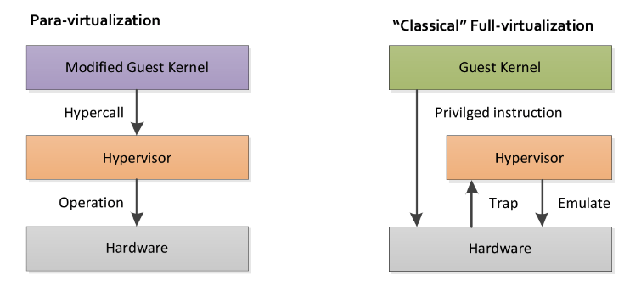
Difference between Full and Para Virtualization

Slide 43
Types of Virtualization- 3. Hardware Assisted Virtualization
Uses special CPU features (like Intel VT-x or AMD-V) to offload virtualization tasks from software to the physical hardware
allowing virtual machines (VMs) to run more efficiently with "near-native" performance by directly handling privileged instructions and memory management,
eliminating the performance bottlenecks of older, software-only methods like binary translation.
CPU itself is configured to trigger a VM-exit when certain instructions/events occur.
Notes:
Intel VT-x: a hardware feature in Intel CPUs that enables efficient running of multiple operating systems (virtual machines) on a single physical computer,

Slide 44
3. Hardware Assisted Virtualization - Benefits
Performance: Near-native performance for VMs due to direct hardware management.
Efficiency: Less CPU overhead compared to software-based methods.
Security: Improved isolation and control over privileged operations.
Simplicity: Streamlined software stacks for hypervisors.

Slide 45
3. Hardware Assisted Virtualization - Benefits

Slide 46
Types of Virtualization- 4. Partial Virtualization
Partial virtualization virtualizes only a subset of hardware resources, while the remaining resources are exposed directly to the guest OS.
Guest OS is modified so that it knows which resources are real and which are virtual
Early CPUs could not virtualize all instructions cleanly, hardware support was missing, full virtualization was inefficient - academic and historical context

Slide 47



Learner knows they are in a driving school simulator
Instead of pressing pedals directly, they ask the instructor
“Please accelerate”, “Please brake”
A car designed with dual controls
Instructor and student both have pedals
The car itself ensures safety
A child is playing a video game driving simulator
The child thinks they are driving a real car
But every action is intercepted and simulated by the game engine
Guest OS = Aware child
Hypervisor = Instructor
Hardware = Real car
Guest OS = Unaware child
Hypervisor = Game engine
Hardware = Real car
Guest OS = Student driver
Hypervisor = Instructor
CPU = Dual-control car

Slide 48
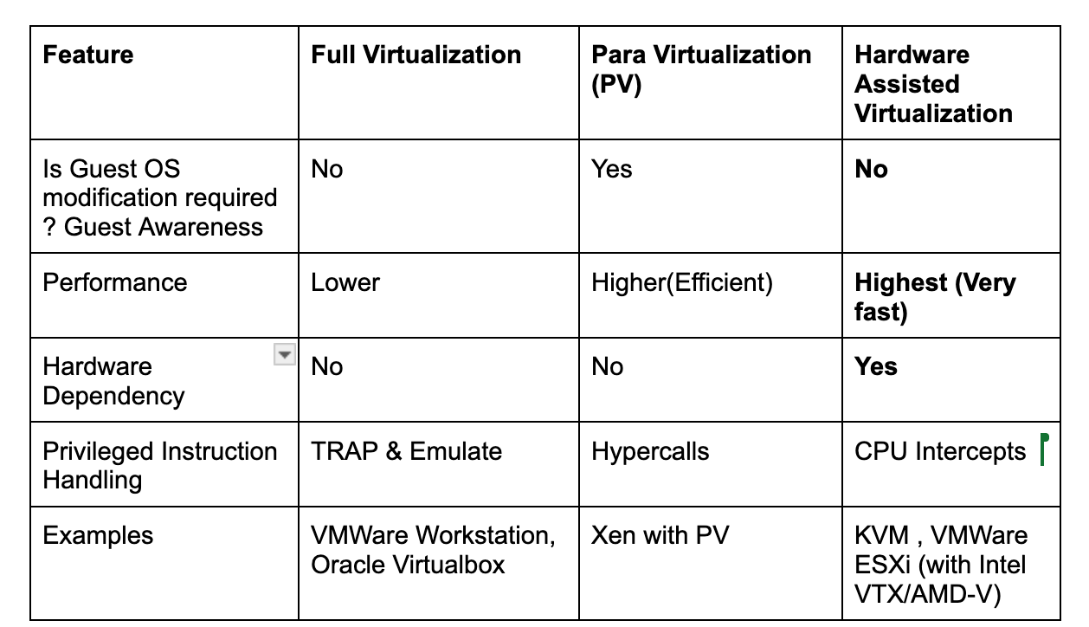

Slide 49
Knowledge Check
Q1. In full virtualization, how are privileged operations handled?
A. Privileged instructions are trapped or binary translated
B. Guest OS issues hypercalls
C. Guest OS executes privileged instructions directly
D. CPU performs VM-exit automatically
Q2. Which virtualization technique requires modification of the guest operating system?
A. Full virtualization
B. Hardware-assisted virtualization
C. Para-virtualization
D. Emulation
Notes:
1 a
2 c

Slide 50
Knowledge Check
Q3. In hardware-assisted virtualization, which entity triggers transfer of control to the hypervisor?
A. Guest OS using hypercalls
B. CPU using VM-exit mechanism
C. Guest OS due to illegal instruction
D. Host operating system
Q4. In which virtualization technique does the guest OS typically run unmodified in Ring 0?
A. Full virtualization
B. Para-virtualization
C. Hardware-assisted virtualization
D. Partial virtualization
Notes:
3 b
4 c

Slide 51
Knowledge Check
Q5. Which of the following correctly orders virtualization techniques from highest to lowest performance?
A. Para → Full → Hardware-assisted
B. Hardware-assisted → Para → Full
C. Full → Para → Hardware-assisted
D. Hardware-assisted → Full → Para
Q6. What is the key advantage of para-virtualization over full virtualization?
A. Guest OS runs unmodified
B. CPU handles virtualization automatically
C. Reduced overhead by avoiding traps
D. No need for hypervisor
Notes:
5 b
6 c

Slide 52
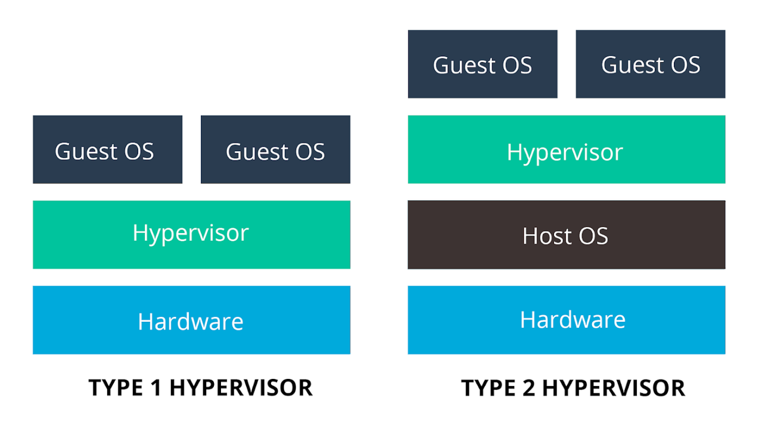
7. Types of Virtualization (Where)
Hosted)
(Bare Metal)

Slide 53
Types of Virtualization (Where)
Parameter
Terminology
Booting
Other Names
Efficiency
Virtualization Support
Availability
Performance
Security
Usage
Examples

Slide 54
Types of Virtualization (Where)
Parameter | Type 1 Hypervisor | Type 2 Hypervisor
Terminology | Runs directly on system hardware | Runs on top of a host operating system
Booting | Boots before any guest OS | Starts after the host OS is running
Other Names | Native / Bare-metal hypervisor | Hosted hypervisor
Efficiency | High, due to minimal overhead | Lower, due to host OS overhead
Virtualization Support | Hardware-assisted virtualization (VT-x / AMD-V) | Hosted (hypervisor-on-OS) virtualization
Availability | High; failure of one VM does not affect others | Lower; host OS failure affects all VMs
Performance | Near-native, very high | Reduced due to extra software layer
Security | Strong isolation, smaller attack surface | Weaker due to host OS vulnerabilities
Usage | Data centres, cloud platforms | Labs, desktops, testing environments
Examples | VMware ESXi, Xen (Citrix XenServer), Microsoft Hyper-V (bare-metal) | VirtualBox, VMware Workstation, Microsoft Virtual PC

Slide 55
Knowledge Check
Q1. Which statement is TRUE regarding performance?
A. Type-2 hypervisors generally provide better performance than Type-1
B. Type-1 hypervisors have higher overhead due to host OS
C. Type-1 hypervisors generally provide better performance than Type-2
D. Performance is identical for both
Q2. In which environment are Type-1 hypervisors most commonly used?
A. Personal desktops
B. Development laptops
C. Cloud data centers
D. Mobile devices
Notes:
1 c
2 c

